Slide 1
Background Check Requirement for
High Schools
Vickie Rundbaken, GaDOE
Family & Consumer Sciences Program Specialist

Slide 2



Students needing background checks are:
Early Childhood Education (ECE) pathway
Teaching as a Profession (TAP) pathway
Work-Based Learning (WBL) program
Youth Apprenticeship Program (YAP)

Slide 3
The following information is from the legal department at
Georgia Department of Early Care and Learning (DECAL): Bright from the Start.
The criminal records page is a great place to visit for FAQ's, recent changes to the law/rules, webinars and general announcements: http://decal.ga.gov/CCS/CriminalRecordsCheck.aspx

Slide 4
In October 1, 2018, federal law required that ALL students (regardless of age) have a satisfactory background check determination issued by DECAL before s/he reports to a licensed childcare learning center or a license-exempt center that receives CAPS subsidy.
Official Code of Georgia Annotated
- Title 20. Education
- Chapter 1A. Early Care and Learning
- Article 2. Background Checks
- 30-45

Slide 5
This ONLY applies to students interning in a:
Licensed childcare learning center (preschool or daycare) from DECAL
  *Further explanation regarding preschools is on the next slide*
OR license-exempt childcare program that receives CAPS (Child Care and Parents Services) subsidy

Slide 6
It does NOT apply to students interning in a facility that is not licensed by the Georgia Department of Early Care and Learning such as an elementary school setting.

Slide 7
Pre-K programs can operate in two settings:
In a childcare learning center which IS licensed by DECAL and where comprehensive background check requirements DO apply; and
In a public school, which IS NOT licensed by DECAL and where comprehensive background check requirements DO NOT apply (unless they receive CAPS: Childcare and Parent Services subsidy).

Slide 8
Do NOT assume that the PreK program is LICENSED.
Use the information on the following slide to determine if the program is licensed or NOT licensed.

Slide 9
Is the PreK program licensed or not??
Go to the following link: https://families.decal.ga.gov/PreK/
Make sure that you have “PreK Programs” tab selected at the top of the search engine.
Enter “Address”, “Facility Name”, “Zip Code”, OR etc.
Then click “Search”

Slide 10
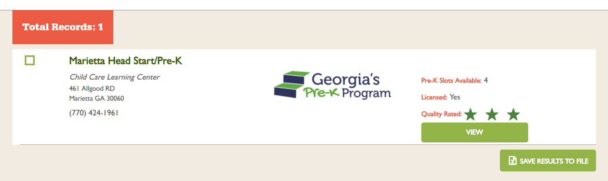
LICENSED
*Background Checks ARE Needed*
Peter Rabbit’s PreK

Slide 11
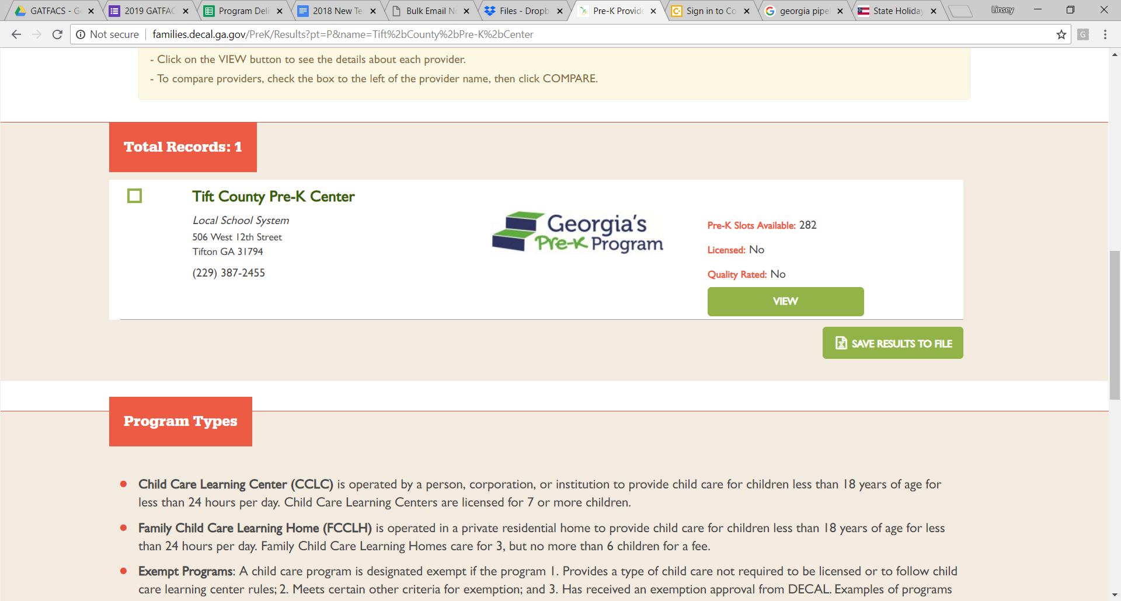
NOT LICENSED & NO CAPS
*Background Check NOT Needed*
Winnie-the-Pooh’s Prek

Slide 12
Do
NOT
Forget
If the program is NOT licensed, but they receive CAPS: Childcare and Parent Services subsidy.
The students will still need a background check.
Use the following link for more information about CAPS: http://decal.ga.gov/QualityInitiatives/CAPS.aspx

Slide 13
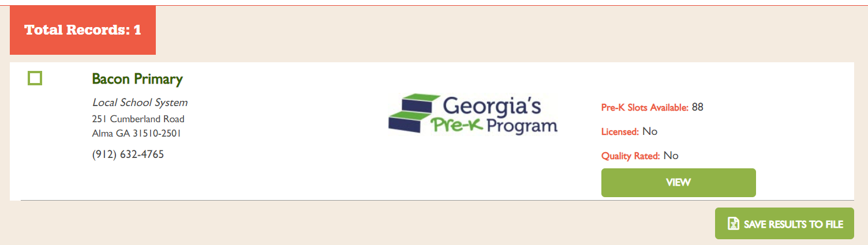
NOT LICENSED & YES CAPS
*Background Checks ARE Needed*
Three Little Bear’s PreK

Slide 14
Based on the previous information, if your students NEED a background check, you MUST continue the presentation.

Slide 15
Background checks MUST be completed the following way.
- This is a two-step process:
1. DECAL (the state agency that regulates childcare in GA) and
2. FieldPrint throught the GBI (the entity that processes the fingerprint scans for DECAL) and NOT through local law enforcement.

Slide 16
Do
NOT
Forget
If the daycare/preschool your students are interning in requires a background check through DECAL, the below steps must be taken. (If unsure, refer to the first bullet point in this document.):
  Submit a records check application electronically through one of the following:
    A DECAL KOALA provider account for a support center;
    A DECAL KOALA provider account for a licensed childcare learning center, or
    The DECAL website https://decalkoala.com/CBCApplication (must select a licensed center or registered support center)
    Fingerprinting Processing – Georgia Applicant Processing Service (GAP)
  https://gbi.georgia.gov/georgia-applicant-processing-service
  Please direct applicants to https://fieldprintgeorgia.com/ to register for fingerprinting and background check services. Gemalto/Thales should no longer be contacted.
  Fingerprinting Site Locations -https://fieldprintgeorgia.com/individuals
  Arranging for a mobile fingerprinting to come to you (there is an additional charge for this service).

Slide 17
Do
NOT
Forget
The current cost to fingerprint for this national clearance is $51.50. There may be an additional cost if you have lived outside of Georgia in the last five years. If the process is started in the morning, the background check can be completed the same day. There may be additional fees if a mobile fingerprinting site is requested or if DECAL must make additional out of state checks.
A school wishing to send student interns into PreK programs may apply to become a Support Center to eliminate the need to submit the records check application through a childcare center. Information about Support Centers and the registration process (which typically takes a week for approval) can be found here: http://decal.ga.gov/CCS/SupportCenter.aspx
Once all of the background check information has been submitted, it takes about two days for this process to be completed. DECAL will determine if the student has passed or failed the background check and will issue a determination letter delivered via email.

Slide 18
If you have any further questions, please reach out to ….
Glen Clardy 404-387-1425
Linwood Stewart 470-876-8319.

Slide 19
Do
NOT
Forget
Links to the Laws:
Federal law that governs all licensed programs and all license-exempt programs that receive CCDF funds (i.e. Childcare and Parents Services subsidy). The citation for the background check portion of the federal law is 42 U.S.C. § 9858f. A link to this section is here: https://www.law.cornell.edu/uscode/text/42/9858f#
GA state law (attached). The relevant sections are O.C.G.A. §§ 20-1A-30 through 45. Please note that the definition of Employee for the purpose of the background check requirements specifically includes students-in-training. https://advance.lexis.com/container/?pdmfid=1000516&crid=021b6da1-3074-44df-9577-ff3fc2b45093&func=LN.Advance.ContentView.getFullToc&nodeid=AAUAADAAD&typeofentry=Breadcrumb&config=00JAAzZDgzNzU2ZC05MDA0LTRmMDItYjkzMS0xOGY3MjE3OWNlODIKAFBvZENhdGFsb2fcIFfJnJ2IC8XZi1AYM4Ne&action=publictoc&pddocfullpath=%2Fshared%2Fdocument%2Fstatutes-legislation%2Furn%3AcontentItem%3A5STN-B2S0-004D-824K-00008-00&pdtocfullpath=%2Fshared%2Ftableofcontents%2Furn%3AcontentItem%3A7YJ8-39M0-Y905-D000-00008-00&ecomp=v3cfkkk&prid=fb98cc80-bdb1-4e61-8a17-9d837734a0cb

